Slide 1


Artificial Intelligence and Data Science
24ADI204 Data Science and Visualization
DATA-VIZ HACK-A-BIT (2026-2027)
CUSTOMER SERVICE CHURN DETECTION
Team Number:
1. GOWTHAM S 25BAD027
2. HARIHARAN B 25BAD030
3. NIZANTH B C 25BAD076

Slide 2
Project Walkthrough
01. Project Scope
07. Data Cleaning
13.Key Insights /Results
02.Problem Statement
08. Outlier Handling
14.Dashboard
03. Objectives
09. EDA
  15.Demo Video
04. Project Workflow
10. Correlation Analysis
16.Future Enhancements
05. Dataset Overview
11. Feature Engineering
17.Team Contribution
06. Target Variable
12. PCA
18.Conclusion/Reference

Slide 3


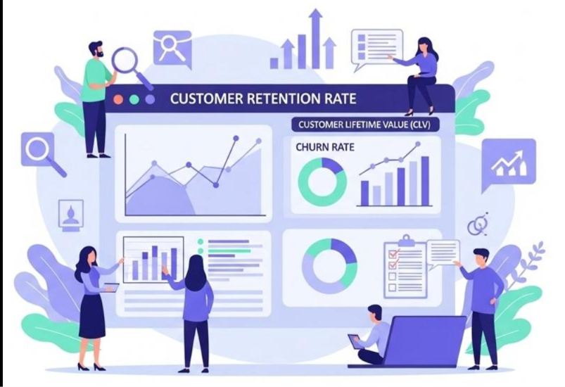
Project Scope
Analyze customer subscription data.
Identify customers who may stop using the service.
Study customer behavior and subscription patterns.
Analyze monthly charges and total charges.
Understand factors related to customer churn.
Use data visualization to present insights.
Support customer retention strategies.

Slide 4
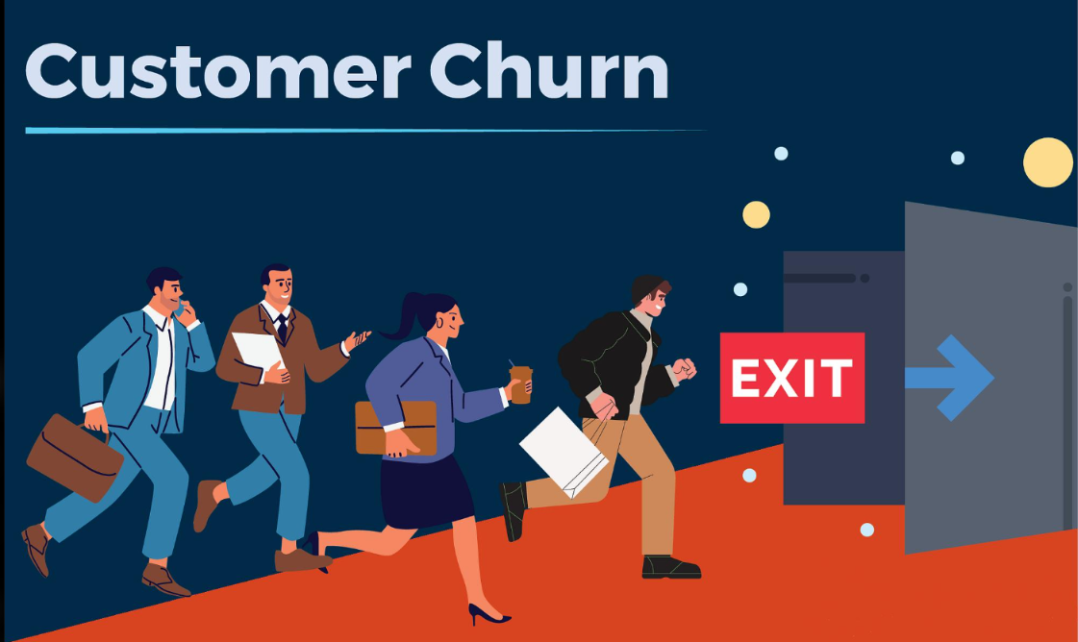
Problem Statement
Subscription services face customer churn.
Churn means customers stop using a service.
Losing customers can reduce business revenue.
Businesses need to understand customer behavior.
Manual analysis of customer data is difficult.
Data analysis helps identify churn-related patterns.
The project focuses on understanding factors associated with churn.

Slide 5
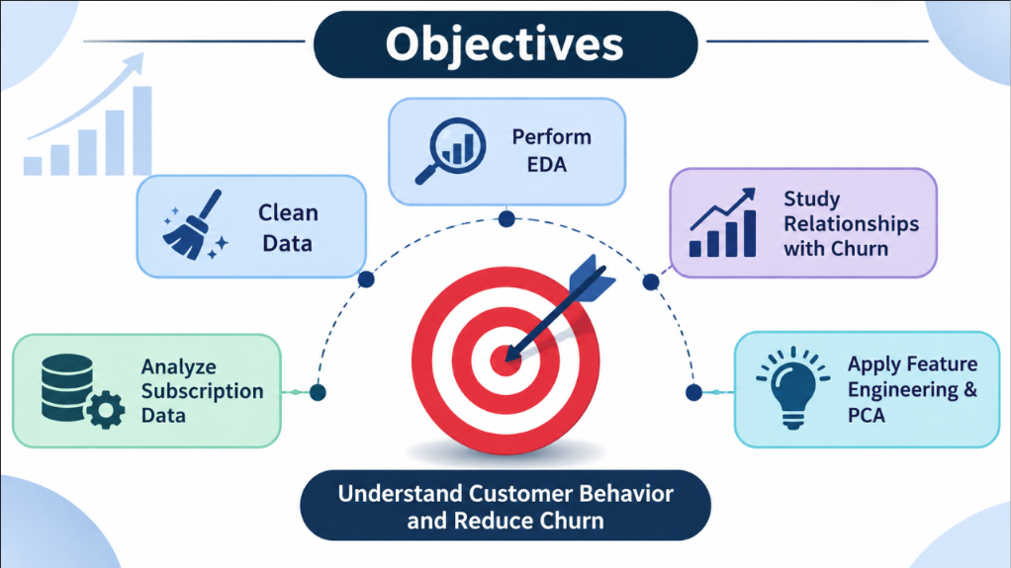
Objectives
Analyze subscription service customer data.
Clean missing and inconsistent data.
Detect outliers in numerical features.
Perform Exploratory Data Analysis (EDA).
Study relationships between features and churn.
Apply feature engineering and data scaling.
Use PCA for dimensionality reduction.
Present findings through visualizations.

Slide 6
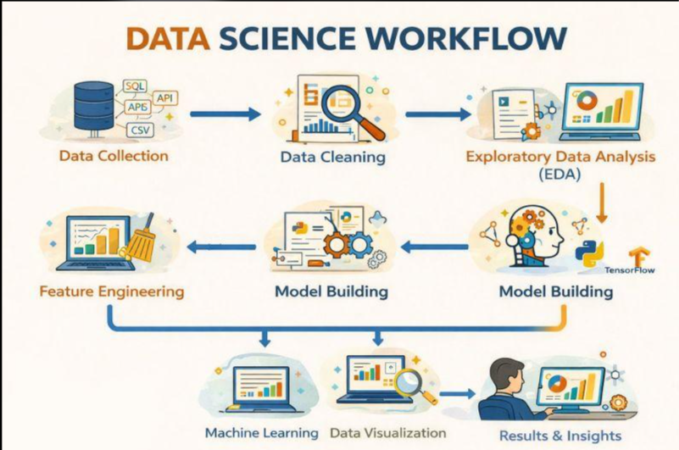
Project Workflow
Data Collection
2. Data Understanding
3. Data Cleaning
4. Outlier Detection
5. EDA and Correlation Analysis
6. Feature Engineering
7. PCA and Visualization
8. Insights and Results

Slide 7
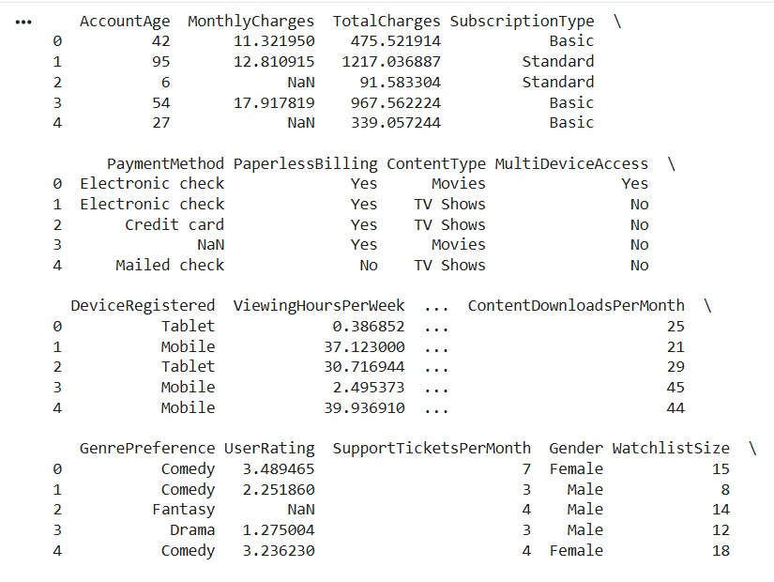
Dataset Overview
Dataset Name: Subscription Service Churn Dataset
Total Records: 963 customers
Original Columns: 21
Target Variable: Churn
Input Features: Customer and subscription details
Numerical Features: Account age, monthly charges, total charges, viewing hours and ratings
Categorical Features: Subscription type, payment method, content type and device
Tools: Python, Pandas, NumPy, Matplotlib and Seaborn

Slide 8

Target Variable
Target Column: Churn
Represents whether a customer has churned.
Used to study customer retention patterns.
Churn = 1: Customer has churned.
Churn = 0: Customer has not churned.
Used to compare customer characteristics with churn status.
Churn counts and percentages can be shown using a bar chart.

Slide 9
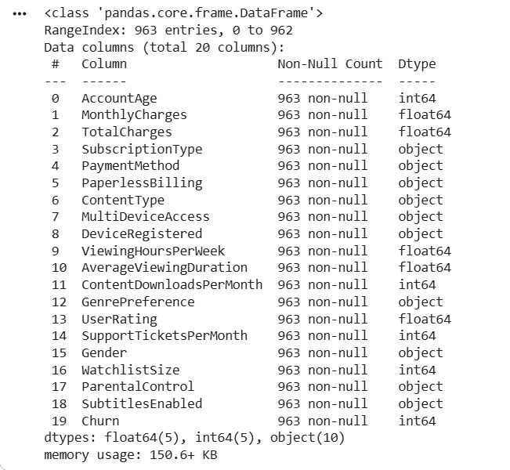
Data Cleaning
Checked dataset structure using Pandas.
Identified missing values in multiple columns.
Found 1,950 missing values before cleaning.
Checked duplicate records & Found 0 duplicate rows.
Filled numerical & categorical missing values using the mean and mode
Removed the CustomerID column.
Final cleaned dataset: 963 rows and 20 columns.

Slide 10
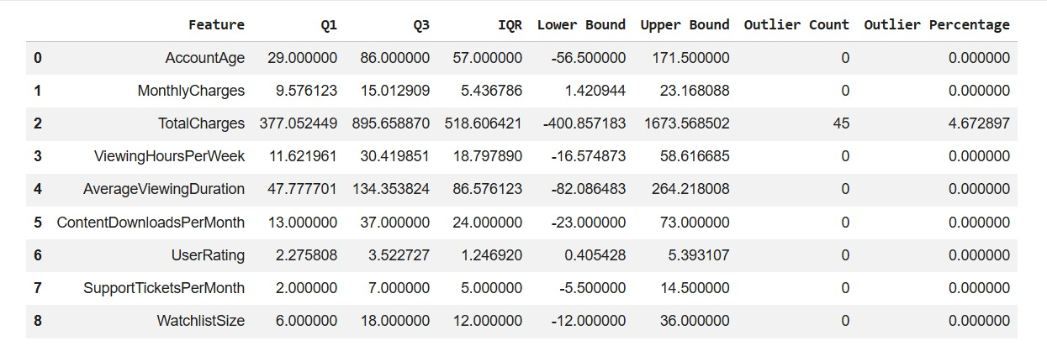
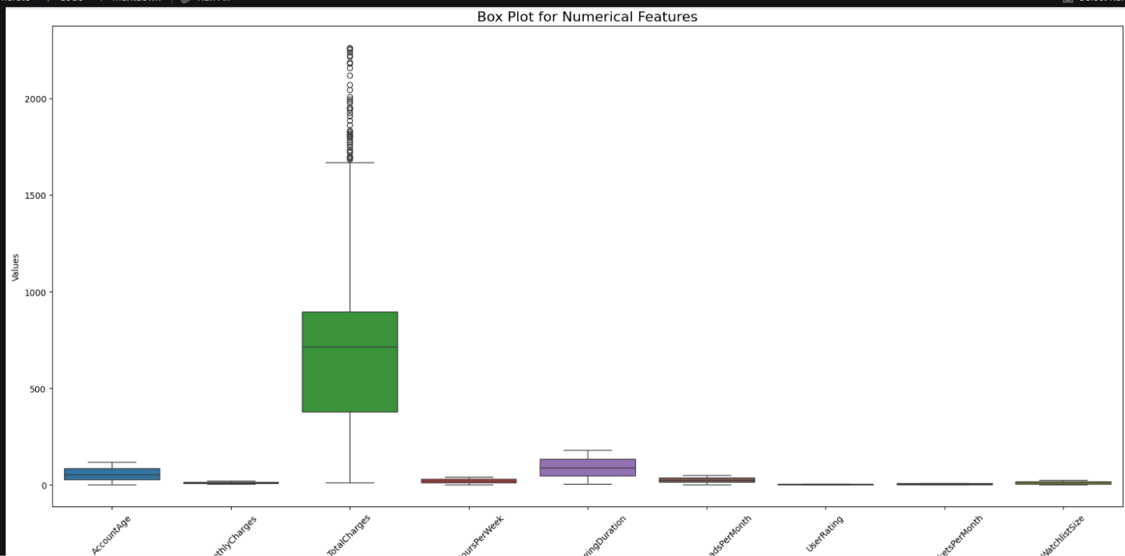
Outlier Handling
Used box plots to visualize numerical features.
Applied the IQR (Interquartile Range) method.
Applied the Z-score method.
Excluded Churn from outlier detection.
IQR detected 45 outliers in TotalCharges.
Z-score detected 10 outliers in TotalCharges.
Other numerical features had no detected outliers using these methods.
Compared results from both techniques.

Slide 11
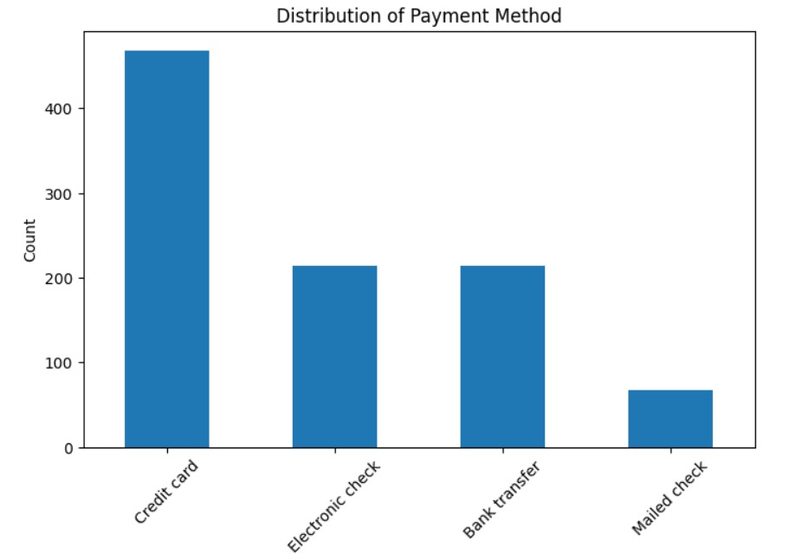
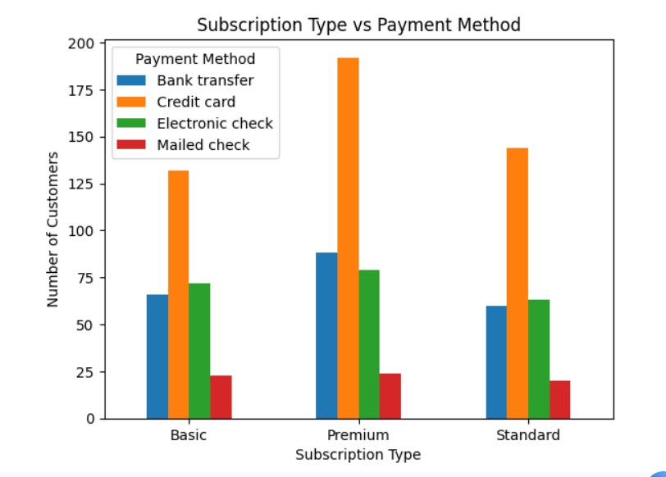
Exploratory Data Analysis
Performed univariate and bivariate analysis.
Studied the distribution of AccountAge.
Analyzed MonthlyCharges and TotalCharges.
Examined UserRating and viewing behavior.
Compared subscription types and payment methods.
Analyzed genre preferences and registered devices.
Used histograms, bar charts, scatter plots and box plots.
Explored relationships between customer features and churn.

Slide 12
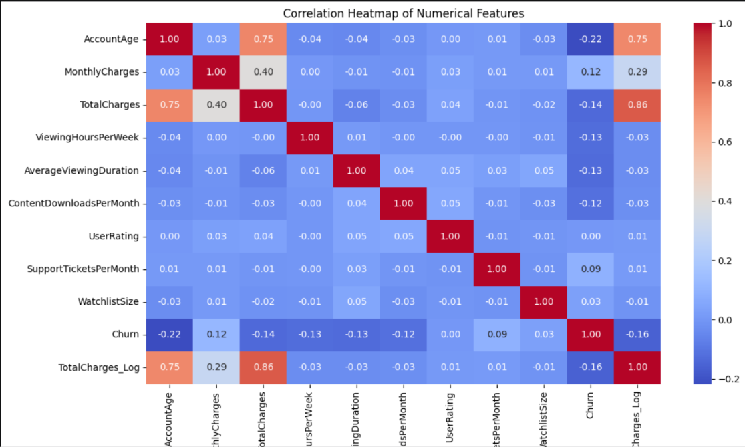
Correlation Analysis
Calculated correlations between numerical features.
Studied relationships with the target variable Churn.
AccountAge correlation with churn: −0.219.
TotalCharges_Log correlation with churn: −0.159.
TotalCharges correlation with churn: −0.137.
UserRating correlation with churn: +0.002.
Used a correlation heatmap to visualize relationships.

Slide 13
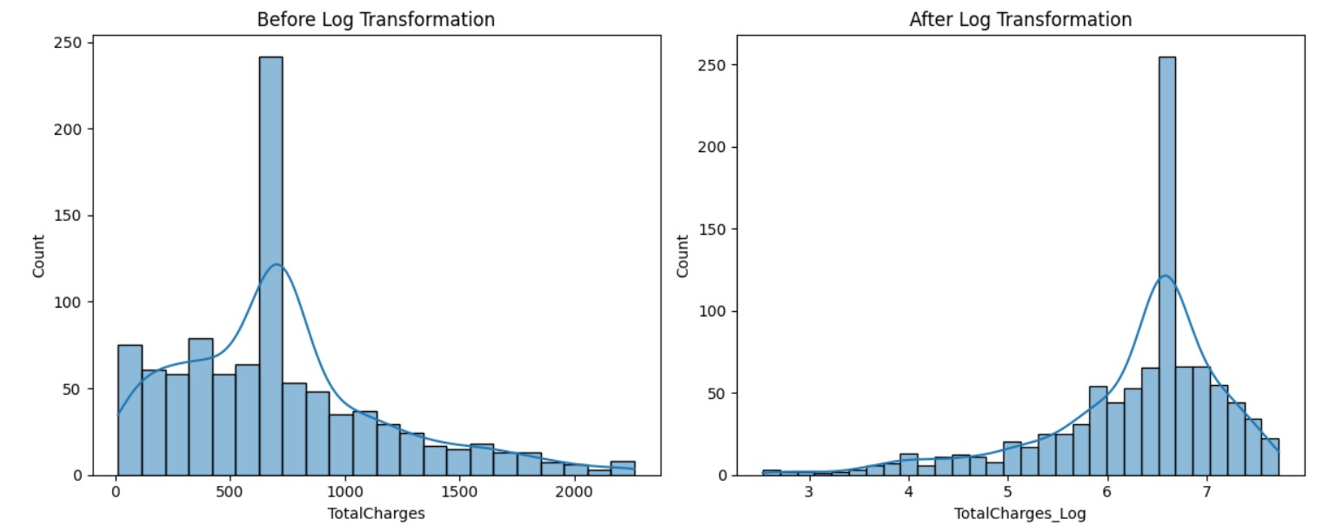
Feature Engineering
Separated input features (X) and target (y).
Identified numerical and categorical columns.
Applied Min-Max Scaling for normalization.
Applied StandardScaler for standardization.
Converted categorical variables into numerical values.
Used one-hot encoding for categorical features.
Applied log transformation to TotalCharges.
Created processed datasets for further analysis.
Original encoded feature count: 29.

Slide 14
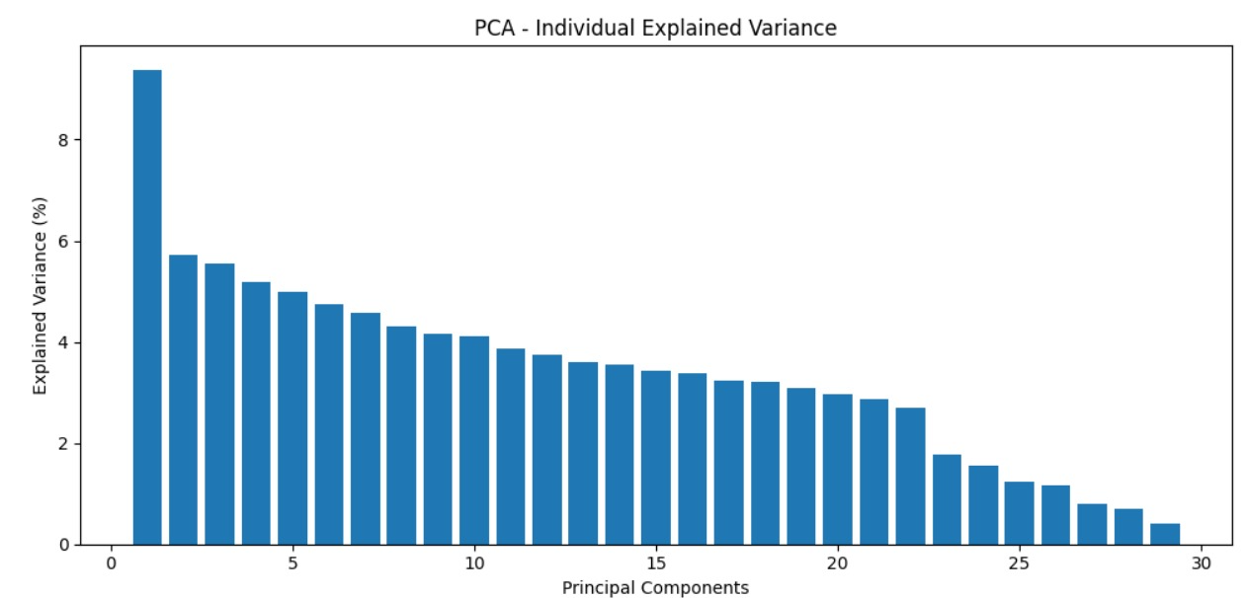
Dimensionality Reduction
Used PCA to reduce the number of features.
Standardized the encoded features before PCA.
Calculated explained variance for each component.
Selected components retaining at least 90% of the
variance.
Original encoded features: 29.
Reduced components: 22.
Total explained variance retained: 92.37%.
Created a PCA scatter plot using PC1 and PC2.

Slide 15
Key Insights / Results
Dataset contains 963 customer records.
Missing values were handled during data cleaning.
No duplicate records were found.
TotalCharges contained detected outliers.
AccountAge had the strongest absolute numerical correlation with churn.
AccountAge showed a negative correlation with churn (−0.219).
Mutual Information ranked AccountAge as the top feature, with a score of 0.0458.
PCA retained 92.37% explained variance.

Slide 16
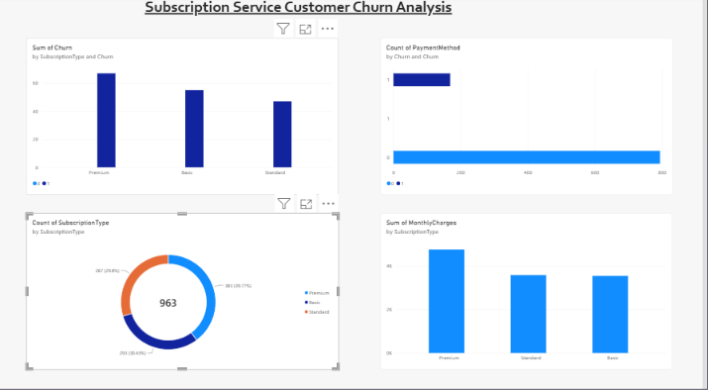
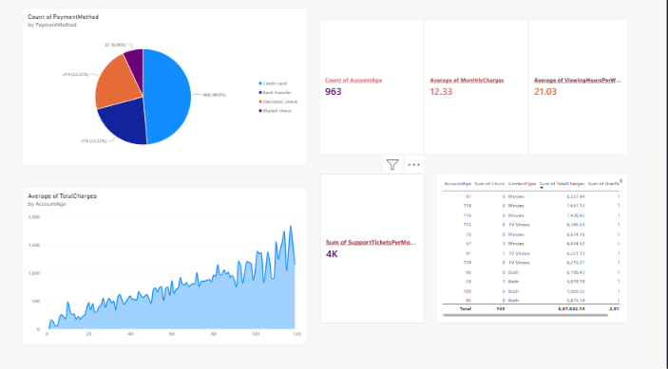
Visualization Dashboard
Dashboard Title: Subscription Service Customer Churn Analysis
Display total customer records.
Show churned and non-churned customer counts.
Visualize churn distribution using a bar chart.
Compare churn across subscription types.
Compare churn across payment methods.
Display monthly charges and total charges.
Show customer age and viewing behavior.
Use filters for subscription type and payment method.
Present key findings using interactive visualizations.

Slide 17
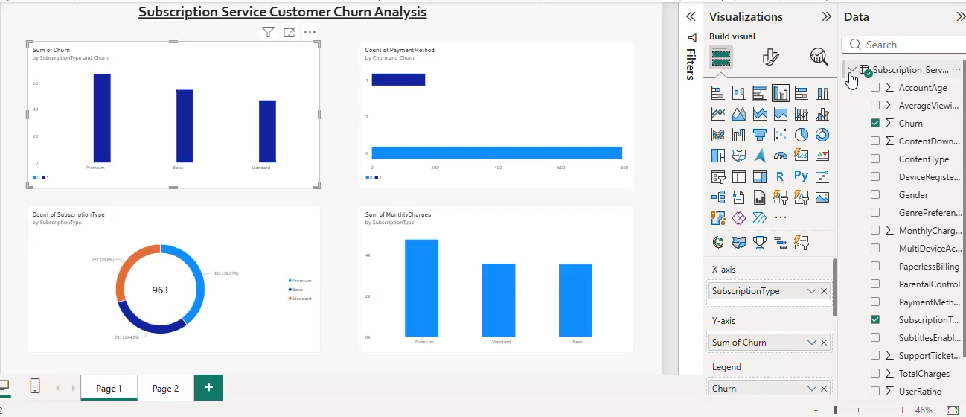
Demo Video

Slide 18
Future Enhancements
Build a machine learning model to predict customer churn.
Compare Logistic Regression, Decision Tree and Random Forest.
Evaluate model performance using accuracy, precision, recall and F1-score.
Identify customers with a high risk of churn.
Develop an interactive dashboard using Power BI.
Recommend personalized customer retention strategies.
Monitor churn trends over time.

Slide 19
Individual Contribution
MEMBERS NAME | Individual Contribution
GOWTHAM S 25BAD027 | Dataset collection, data cleaning, and preprocessing.
HARIHARAN B 25BAD030 | EDA, outlier detection, and correlation analysis.
NIZANTH B C 25BAD076 | Feature engineering, PCA, visualization, and PPT preparation.

Slide 20
Conclusion and References
Conclusion
Analyzed customer data to understand churn patterns.
Cleaned data and handled missing values and outliers.
Identified important features related to customer churn.
Used EDA, correlation analysis, and PCA.
The insights help businesses improve customer retention.
References
Subscription Service Churn Dataset.
Python and Pandas documentation.
NumPy documentation.
Matplotlib and Seaborn documentation.
Scikit-learn documentation for scaling, feature selection and PCA.
Jupyter Notebook: churn_detection_(1).ipynb.

